Slide 1
Bell Work: Is it a relation? Is it a function? Identify the domain and range. (4, 15) (5, -2) (4, 15) (-62, 15) (0, 12) (1/2, 92) (0, 0) (-8, 12)

Slide 2
For Last Time…
New Material
Page 64 #1-5, 11-15, 17-19, 35

Slide 3
ALGEBRA 3
Day 16

Slide 4
Chapter 2 Section 3 Linear Equations
Objective: Find the slope of a line, and write an equation in slope intercept form
HLQ: Explain how/why you think that mathematicians named the formulas “Slope-Intercept” and “Point-Slope” instead of something else.

Slide 5
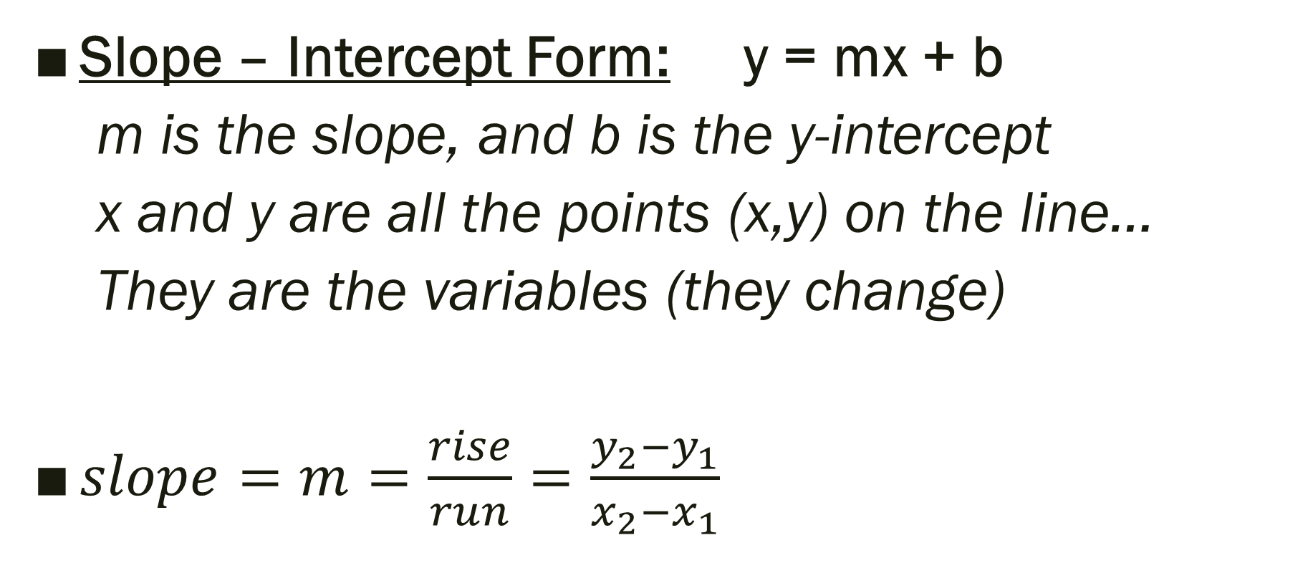
Linear Equations:
Slope – Intercept Form: y = mx + b
m is the slope, and b is the y-intercept
x and y are all the points (x,y) on the line…
They are the variables (they change)
$slope=m=\frac{rise}{run}=\frac{y_{2}−y_{1}}{x_{2}−x_{1}}$

Slide 6
Write the equation given the following information. Use your graphing calculator to check.
1.) m = 3/5 and b = - 4
2.) slope is -2 and the y-intercept is 5
3.) the line passes through (0, 3) and (5, 9)

Slide 7
Graphing (with or without a calculator)
With a calculator:
Write the equation in slope-intercept form by solving for y
Trace to 2 points on the graph
Plot the two points on the graph paper
Without a calculator:
Write the equation in slope-intercept form by solving for y
Find and plot the y-intercept (0, b)
Find the slope (m) and use it to plot a second point
Draw a line through the two points
* or make a t-chart

Slide 8

Examples: Graph. And State Domain and Range
1.) y = $\frac{2}{5}$x – 1
2.) 6x + 2y – 10 = 0
3.) y = 2

Slide 9
For Next Time…
New Material
Page 78 #1, 3, 5, 9, 19, 23, 29, 33, 49
Mixed Review
Page 80 #67-70

